Slide 1


Coronavirus Tweet Sentiment Analysis
CAPSTONE PROJECT
Presented By: Lakshay Rao

Slide 2
Outline
TOPIC :- Coronavirus Tweet Sentiment Analysis
Proposed System/Solution
System Development Approach
Algorithm & Deployment
Result
Conclusion
References

Slide 3
Problem Statement (as per given)
This challenge asks you to build a classification model to predict the sentiment of COVID-19 tweets .The tweets have been pulled from Twitter and manual tagging has been done then. The names and usernames have been given codes to avoid any privacy concerns.

Slide 4
Proposed Solution
Introduction: The proposed system aims to address the challenge of predicting the sentiment of COVID-19 tweets. By leveraging advanced machine learning techniques, we intend to classify the sentiment of tweets related to COVID-19 accurately.
Components of the Solution:
Data Collection:
Gather a large dataset of COVID-19 tweets from Twitter.
Ensure manual tagging of tweets for sentiment analysis to avoid privacy concerns.
Employ data anonymization techniques to protect user identities.
Data Preprocessing:
Clean and preprocess the collected data to remove noise, irrelevant information, and ensure consistency.
Handle missing values and outliers appropriately.
Tokenization and stemming to prepare text data for analysis.
3. Machine Learning Algorithm:
Implement various machine learning algorithms such as Naive Bayes, Logistic Regression, random forest , XGboost and Catboost for sentiment classification.
Conclusion: The proposed solution offers a robust framework for sentiment analysis of COVID-19 tweets, enabling users to gain insights into public sentiment during the pandemic. By accurately classifying tweets, we can better understand public opinion and tailor interventions accordingly.

Slide 5
System development Approach
IMPORTING LIBRARIES / DATA INSPECTION
Pandas
WordCloud
Matplotlib
Seaborn
Nltk
Sklearn
Numpy

Slide 6
EDA ANALYSIS
‎

Slide 7
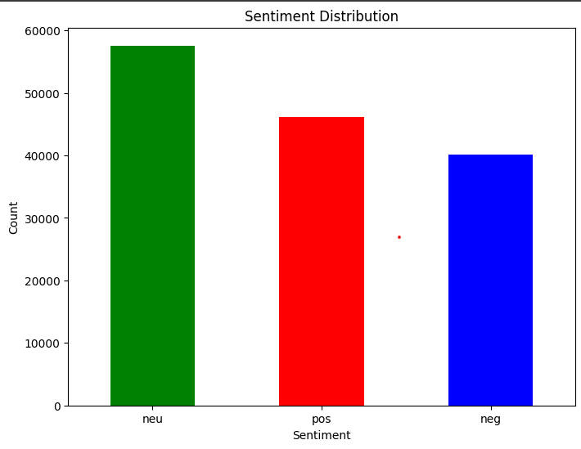
Eda on sentiment analysis

Slide 8
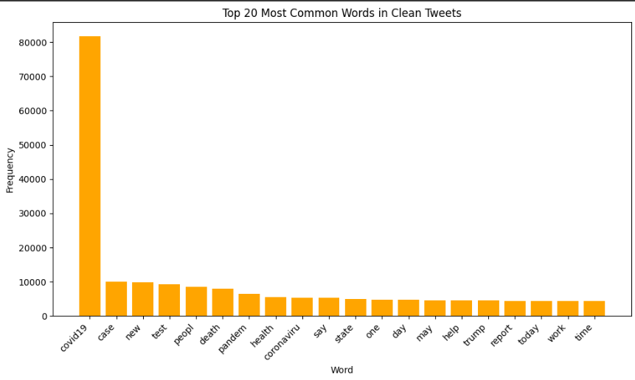
Eda on clean tweets

Slide 9
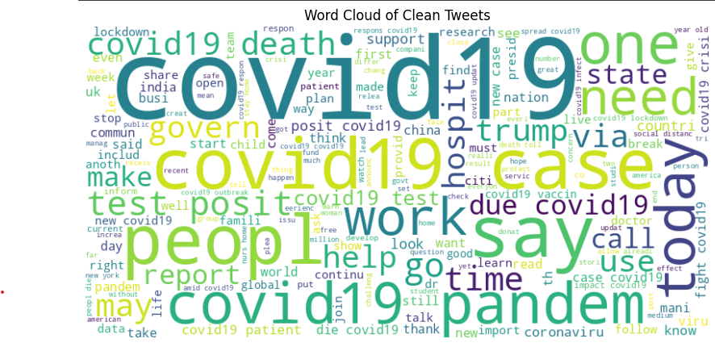
Word cloud of clean tweets

Slide 10
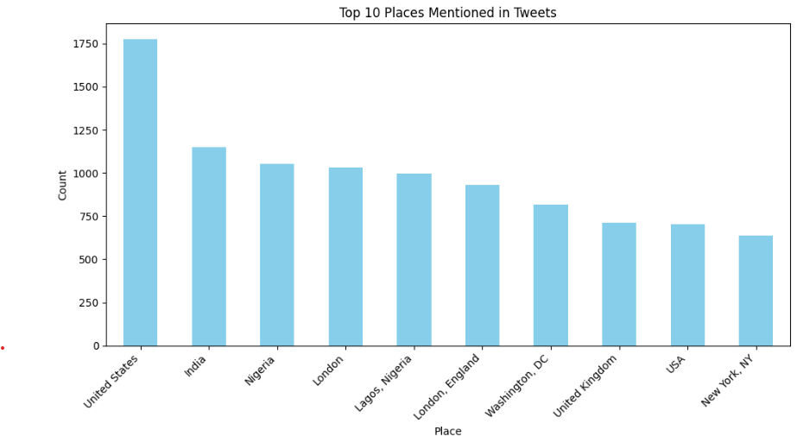
EDA on location of tweets

Slide 11
Data pre-processing
STEMMING
Stemming is a process of stripping the rule-based process of suffixes from a word .
This process simplifies the text and helps in text analysis tasks such as sentiment analysis, where the focus is on the core meaning of words rather than their specific variations.
For Example:-
Original Sentence: "I was riding my bicycle when I saw many bikes riding beside me."
After stemming, the sentence might be transformed to: "I was ride my bicycl when I saw mani bike ride beside me.”
Stemming has reduced different variations of the words "riding," "bicycle," and "bikes" to their common root form "ride" and "bike."

Slide 12
tokenization
In this process , a group of sentences is converted into a token . It is also called as “ text Segmentation” or “Lexical Analysis”.
This can be done by python’s NLTK library’s word_tokenize() function .

Slide 13
AlgorithmS USED
To calculate the test accuracy and the validation accuracy , various models have been used such as
Naïve Bayes
Logisitic Regression
Random Forest
XGBoost
CatBoost.
We have also found the all the test’s accuracy.

Slide 14
Naïve bayes
It's a probabilistic classifier based on Bayes' theorem with the "naive" assumption of independence between features. It's simple and efficient, often used for text classification tasks like sentiment analysis.
Binary classification accuracy
Training accuracy score ; 0.9955786035683883
Validation Accuracy: 0.9957610923873389
Multiclass classification accuracy
Training Accuracy: 0.9714911137749518
Validation Accuracy: 0.9720301587853097

Slide 15
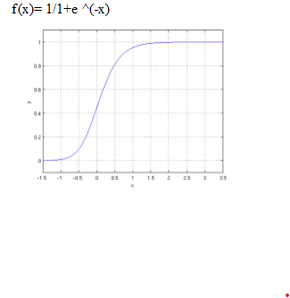
Logistic regression
It's a linear model used for binary classification tasks. It estimates the probability that a given instance belongs to a particular class.
Binary classification accuracy
Training Accuracy: 0.9949792394155765
Validation Accuracy: 0.9945450123345263

Slide 16
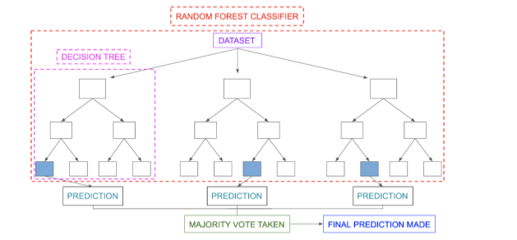
Random forest
It's an ensemble learning method that constructs multiple decision trees during training and outputs the mode of the classes (classification) or mean prediction (regression) of the individual trees.
Training Accuracy: 1.0
Validation Accuracy: 0.9998957645669018

Slide 17
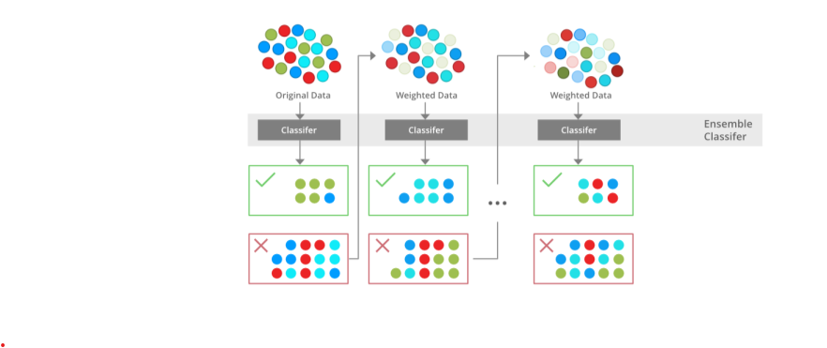
xgboost
It's an optimized implementation of gradient boosting, a machine learning technique that builds a series of weak learners (typically decision trees) sequentially, where each new model corrects the errors of its predecessor.
Training Accuracy: 1.0
Validation Accuracy: 0.9998957645669018

Slide 18
catboost
It's a gradient boosting library that is particularly effective for categorical features. CatBoost automatically handles categorical variables and reduces the need for extensive data preprocessing.
Training Accuracy: 1.0
Validation Accuracy: 1.0

Slide 19
Deployment
The above performed observations and the training on various models have been done on Google colaboratory and deployed there only.
Training of model on the given dataset and running all the algorithms have been done on Google Colab itself only.

Slide 20
Result ( Multiclass classification)
Test accuracy for Multinomial Naive Bayes :0.7276475493375336
Test accuracy for Logistic regression Test Accuracy : 0.9895764566901776
Test accuracy for Random forest Test Accuracy :0.9978458010493033

Slide 21
Result ( binary class classification)
Test accuracy for Multinomial Naive Bayes : 0.7269031652826518
Logistic regression Test Accuracy: 0.9895764566901776
Random forest Test Accuracy: 0.9978458010493033

Slide 22
Conclusion
Majority of the Tweets were around 250 characters long , indicating that there was a lot of interest in COVID -19 among the general public .
More neutral tweets than positive and negative were tweeted (or X’ed ) globally.
United states became the country with most number of tweets followed by India .
Words like “covid19” , “case” , “pandemic” , “deaths” , “trump” were used the most in tweets indicating that people were aware about the pandemic and were constantly discussing the same in online space (mostly in the United States.)

Slide 23
References
Like It or Not: A Survey of Twitter Sentiment Analysis Methods (On Google Scholar by Giachanou and Fabio Crestani)
Comparison Research on Text Pre-processing Methods on Twitter Sentiment Analysis ( IEEE Explore)
And exploration and reading of documentation on several websites on the internet.

Slide 24
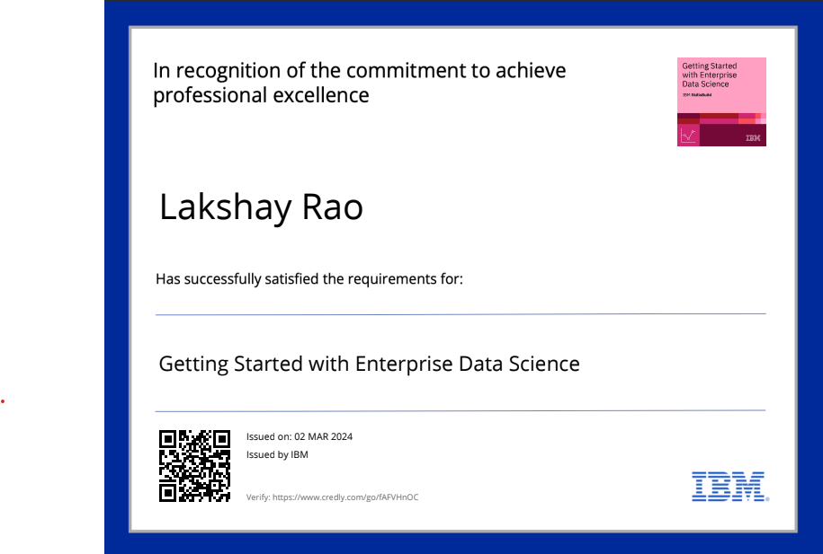
course certificate 1

Slide 25

course certificate 2

Slide 26
THANK YOU

